Slide 1
Képszintézis
Physically Based Rendering
Szécsi László

Slide 2
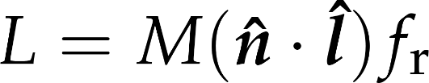
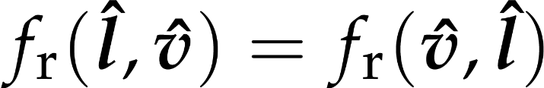
Rendering egyenlet egy bejövő irányra
radiancia:
fizikailag plauzibilis, ha:
az energia megmarad (az albedo < 1)
szimmetrikus (Helmholtz törvény)
a felületnek valamilyen elvi modelljét használja
nem empirikus
ez mindig a mikrofelület-modell
Notes:
Our first model is for very rough surfaces where all photons get reflected multiple times. Such materials (snow, sand, wall, chalk, cloth etc) have a matte look, they look the same from all viewing directions. Thus, the radiance, which equals to the incident radiance times the BRDF times the geometry term, is independent of the viewing direction. Incident radiance and the geometry term are already independent of the viewing direction, thus the BRDF must also be independent of the viewing direction. According to Helmholtz reciprocity, if the BRDF is independent of the viewing direction, it must be independent of the illumination direction as well, so the BRDF is direction independent.
Diffuse surfaces correspond to very rough surfaces where a photon collides many times. The Fresnel depends on the wavelength, which is strong for metals and weak for non-metals. Even if a single reflection changes the spectrum just a little, multiple reflections amplify this effect, so the final reflected light will have a modified spectrum. Diffuse reflection is primarily responsible for the “own color” of the surface.

Slide 3
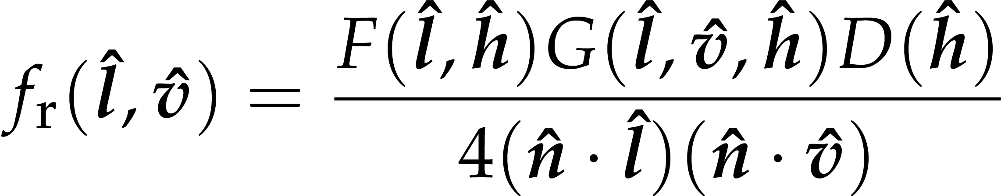
Microfacet BRDF

Slide 4
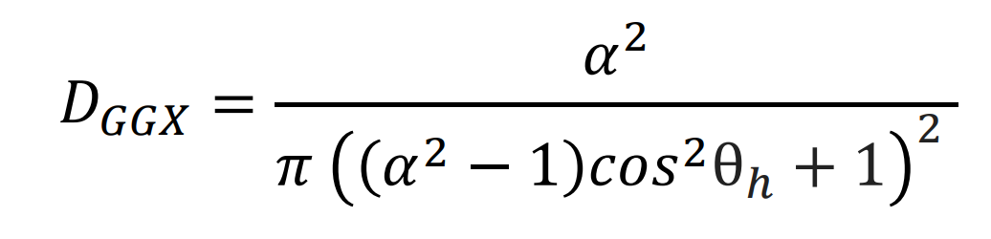
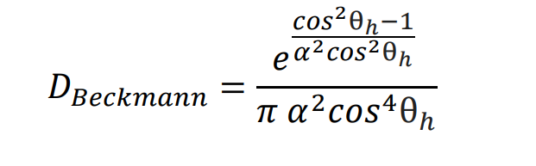
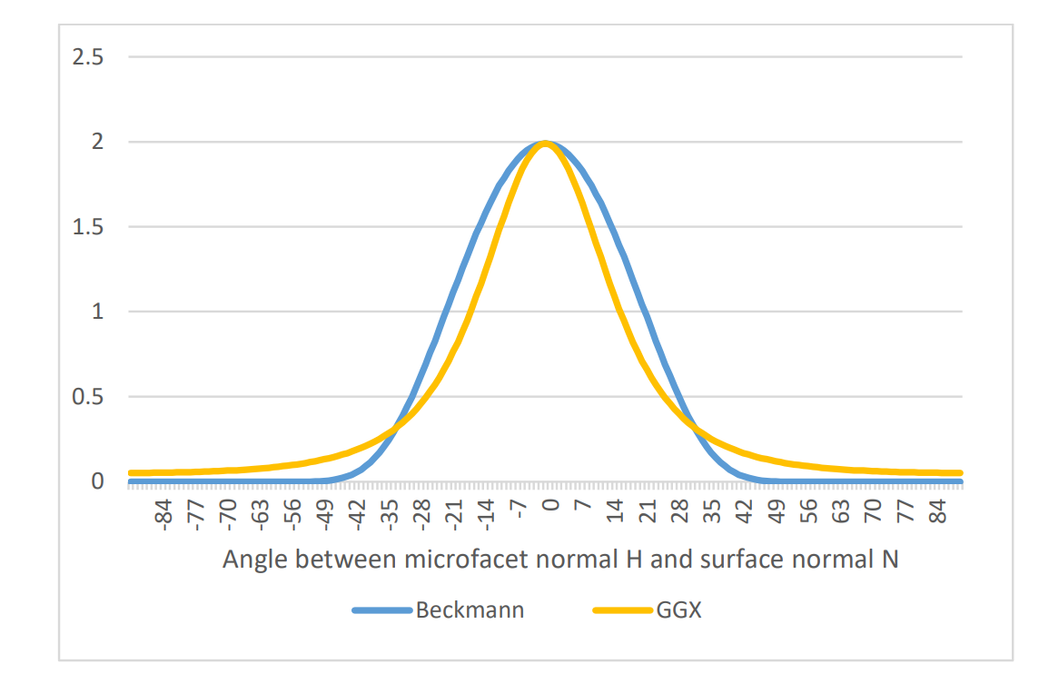
Eloszlás (D) a.k.a. NDF
Trowbridge-Reitz

Slide 5
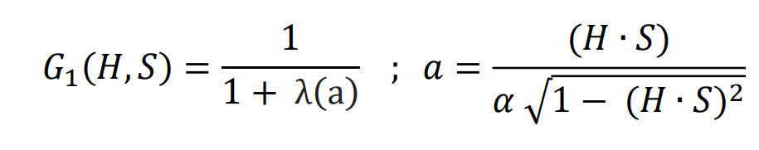
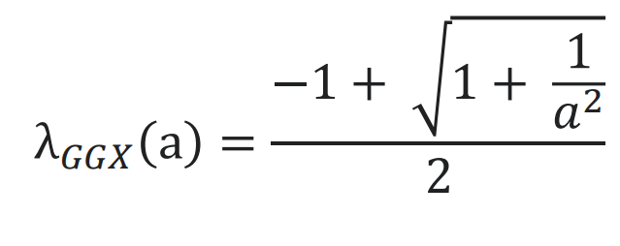
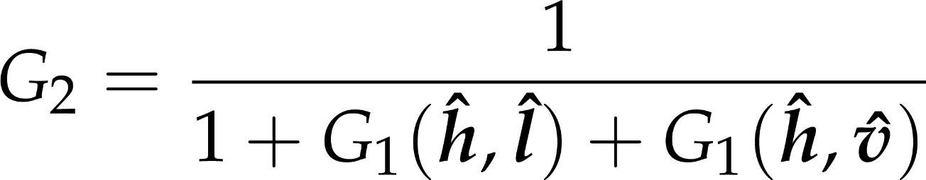
Takarás (G)

Slide 6
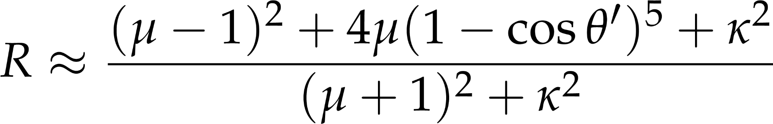
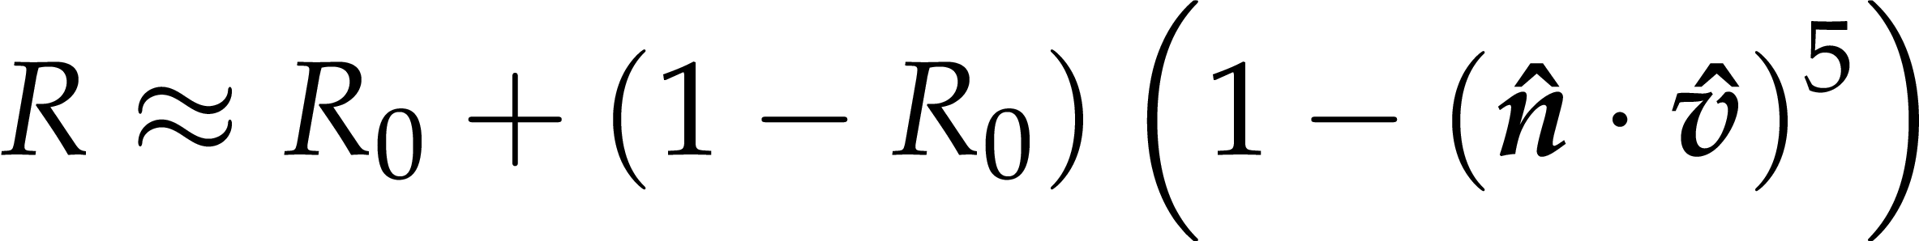
Fresnel F – Schlick közelítés
R0 ~ 0.04 (0.02 a víz, 0.18 a gyémánt) dielektrikumokra
fémekre hosszámhosszfüggő = kd
metalness

Slide 7
Phong-Blinn árnyalás (GLSL)
vec3 shade( vec4 ksg,
vec3 normal, vec3 viewDir,
vec3 lightDir, vec3 lightPowerDensity){
float cosTheta = dot(normal, lightDir);
if(cosTheta < 0) return vec3(0.0,0.0,0.0);
vec3 halfway = normalize(viewDir + lightDir);
float cosDelta = dot(normal, halfway);
if(cosDelta < 0) return vec3(0.0,0.0,0.0);
return lightPowerDensity * ksg.xyz
* pow(cosDelta, ksg.w);
}
};

Slide 8
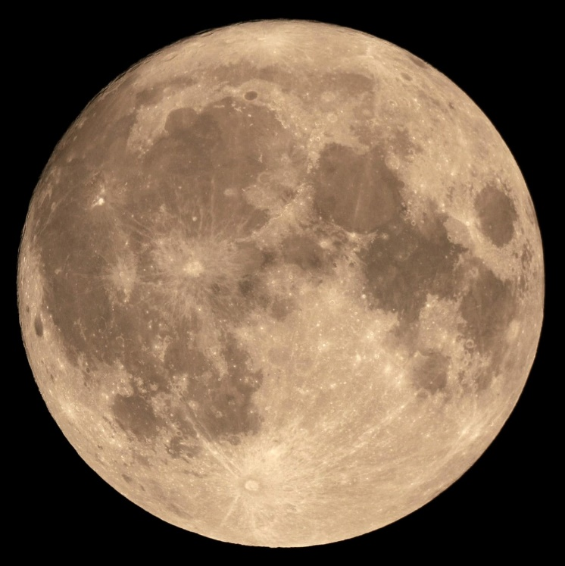
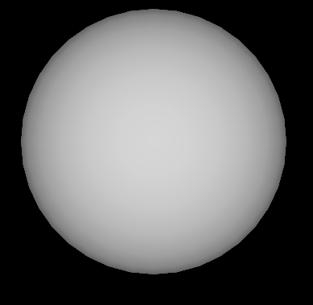
Diffúz az lamberti?

Slide 9
Oren-Nayar képlet
Lambert
Szorozva egy irdatlan bonyolult korrekciós taggal
Ami 0, ha a roughness 0
Különben theta, fi szögektől függ

Slide 10
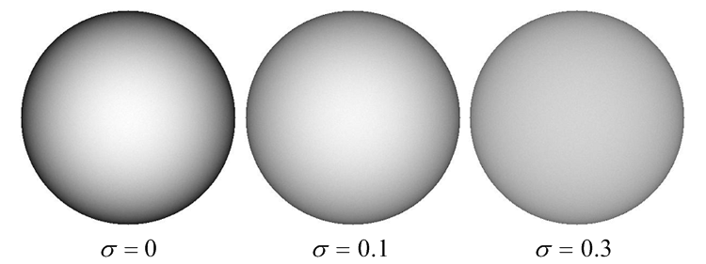
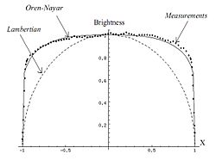
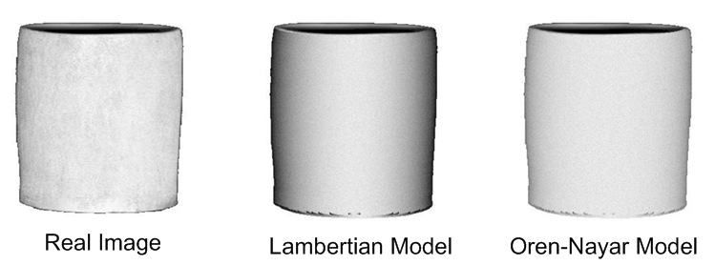
Oren-Nayar
Microfacet modell
De most minden kis felületdarab önmagában diffúz

